Slide 1
Cis 7 – discrete structures
Lecture 11: Introduction to sets

Slide 2
Set theory
A well-defined collection of distinct objects
Well-defined: It is absolutely clear whether or not an object belongs in the set
Objects: Can be anything (abstract or concrete). In math, usually refers to numbers
Notation
a ∈ S
“a is an element of the set S”
If S is the set of all even numbers, then:
2 ∈ S
3 ∉ S

Slide 3
More Notation
List notation:
We can represent the set of all integers between 1 and 3 as: { 1, 2, 3 }
All positive integers: { 1, 2, 3, 4 … }
We use “…” to denote an infinite pattern
All multiples of 3: { ? }
Set in list notation should be distinct
{ 1.1, 2.2, 3.4, 1.1, 2.2 } is not valid
{ 1.1, 2.2, 3.4 } is valid
Order is not important
{ 1.1, 2.2, 3.3 } = { 3.3, 2.2, 1.1 } = { 2.2, 3.3, 1.1 } etc

Slide 4
Examples
Integers = {?}
Fibonacci Numbers = {?}
Playing Cards = {?}
C++ 14 Reserved Words = {?}
Sounds heard on Old MacDonald’s Farm = {?}
People that are right when they say Greedo shot first = { }

Slide 5
More terms
Element: Any object in a set is considered to be an element of that set.
Given S = { Positive Numbers }, 2 is an element of S, while -1 is NOT
Cardinality: How many elements are in a set
Denoted with |x|
Given the set Colors = { blue, red, green, blue, yellow }, what is the cardinality of Colors

Slide 6
Subsets
A set can be an element of a set
Given N = set of all negative numbers
P = set of all positive numbers
A = set of all numbers
Define as ?
{ N, 0, P }

Slide 7
Proper Subsets
A is a “proper” subset of B when it is a subset AND ALSO there are elements of B that are not in A
Formal logic definition of a subset:
(∀ x)[x ∈ A ⇒ x ∈ B]
Formal logic definition of a proper subset:
(∀x)[x ∈ A ⇒ x ∈ B] ^ (∃y)[y ∈ B ^ y ∉ A]
Notation:
Subset: A ⊆ B
Proper Subset: A ⊂ B

Slide 8
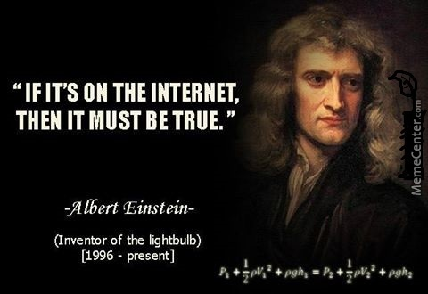
Power set
INTERNET: “A power set is a string of exercises done in succession as one single set.”

Slide 9
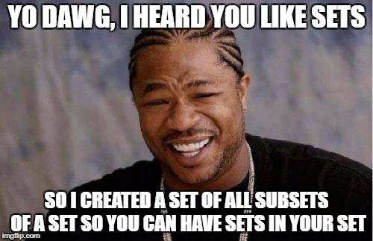
POWER SET (for real)
Set of all subsets of a set

Slide 10
POWER SET (FOR REAL REAL THIS TIME)
List all of the subsets of the set { 1, 2, 3 }
Note that Ø is implicitly included in all sets
{Ø, {1},{2},{3},{1,2},{1,3},{2,3},{1,2,3}}
How about { A, B }
{Ø,{A},{B},{A,B}}
{ DOG }
{Ø,{DOG}}
What do you notice about the cardinality of these powersets?
2^n

Slide 11
Building sets
Given S = { Negative Even Integers }
{ … -6, -4, -2 }
Can we build a predicate to build the set?
We can create even integers by multiplying an integer by 2.
We can create negative integers by simply stipulating that each value must be < 0
Our set can be define as { 2n } where n must be an integer and n must be < 0
Notation: { 2n | n ∈ Z, n < 0 }

Slide 12
Building Set examples
Example: Build a set of all of the positive multiples of 3
{ 3n | n ∈ Z, n > 0 }
Example: All students that brought their own computer
{ n | n ∈ Students, n ∈ Brought Computer }
What are the elements of this set?
{ n*n | n ∈ Z, -3 < n < 3 }

Slide 13
Set Operations: Cartesian product
A X B = { (a,b) | a ∈ A and b ∈ B } **(a,b) is an ORDERED PAIR
Example: let A = { keyboard, ceiling, smelly }, let B = { cat, dog }
A X B = { (keyboard,cat), (keyboard, dog), (ceiling,cat), (ceiling,dog), (smelly,cat),(smelly,dog) }
Example: let A = { 1, 2, 3 }, let B = { a, b, c }
A X B = {(1,a),(1,b),(1,c),(2,a),(2,b),(2,c),(3,a),(3,b),(3,c)}
Give formal logic definition of A X B X C (see A X B above)
A X B X C = { (a,b,c) | a ∈ A, b ∈ B, c ∈ C }

Slide 14
Set Operations: Cartesian product
Cardinality:
|A X B| = ?
|A| * |B|

Slide 15
Cartesian products: practice
Given A = { 1, 5, 10 }, B = { a, b, c }, C = { dog }
A X C =
C X A =
C X B X A =
Ø X C =
C X C X B =

Slide 16
Set operations: compliment
Given: There is a Universe to which all sets belong. Then: The compliment of a set A is the set of all elements in the Universe which are NOT in A.
Given a universe of { 1, 2, 3, 4, 5 }, and A = {1, 2, 3} then A’ is {4, 5}
Notation: A’ = U – A or { x | x ∉ A }

Slide 17
Set operations: intersection
Given sets A & B, the intersection of A & B (A ∩ B) consists of all elements that exist in both sets
A = { 1, b, dog }, B = { b, dog, trash panda }, then A ∩ B = ?
{ b, dog }
Notation: A ∩ B = { x | x ∈ A and x ∈ B }

Slide 18
Set operations: Union
Given sets A & B, the union of A & B (A ∪ B) consists of all elements that exist in either A or B or both
A = { 1, b, dog }, B = { b, dog, trash panda }, then A ∪ B = ?
{ 1, b, dog, trash panda }
Notation: A ∪ B = { x | x ∈ A or x ∈ B }

Slide 19
Set operations: DIFFERENCE
Given sets A & B, the difference of A & B (A - B) consists of all elements that exist in either A or B but not both
A = { 1, b, dog }, B = { b, dog, trash panda }, then A - B = ?
{ 1 }
B – A = ?
{ trash panda }
Notation: A - B = { x | x ∈ A and x ∉ B }

Slide 20
Exercise
Find sets A and B where:
A – B = { 4, 6, 8 }
B – A = { d, e, f }
B ∩ A = { 1, a, 2, b, 3, c }

